Slide 1
Database System (CS-103)
SQL-Function (Aggregate Functions, Single Row function)
Mr. Hamza Javed,
Department of Computer Science,
Muslim Youth University, Islamabad, Pakistan

Slide 2
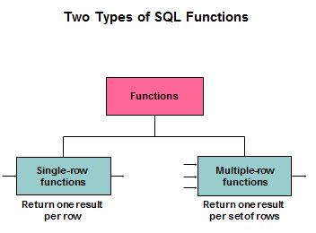
SQL –Function

Slide 3
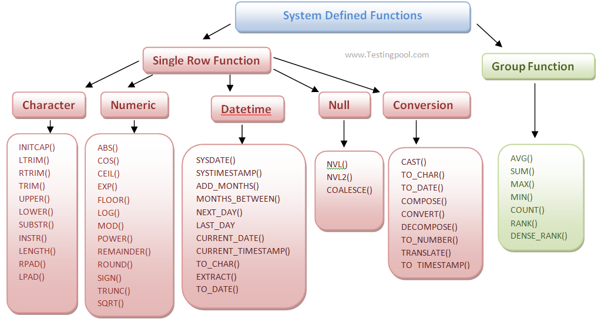
SQL – Functions

Slide 4
Aggregate Function
Table : Employee
Count(column_name)
Max(column_name)
Min(column_name)
Sum(column_name)
Avg(column_name)
Name | Age | Gender | Salary
Fakhar | 19 | Male | 45000
Ahsan | 18 | Male | 55000
Fahad | 20 | Male | 60000
Ayesha | 21 | Female | 90000
Nimra | 20 | Female | 56000
Saad | 19 | Male | 42000
Sadia | 21 | Female | 70000
Madiha | 20 | Female | 87000

Slide 5
Aggregate Function (Syntax)
Syntax:
Select count(column_name) from table_name where condition;
Example:
SELECT count(id) AS Calcualted FROM sectionc.info;
OR
SELECT AVG(phone) AS Calcualted FROM sectionc.info;

Slide 6
SQL - Single Row Function
Date Functions
General Functions
Numeric Functions
Character Functions
Case Conversion Functions

Slide 7
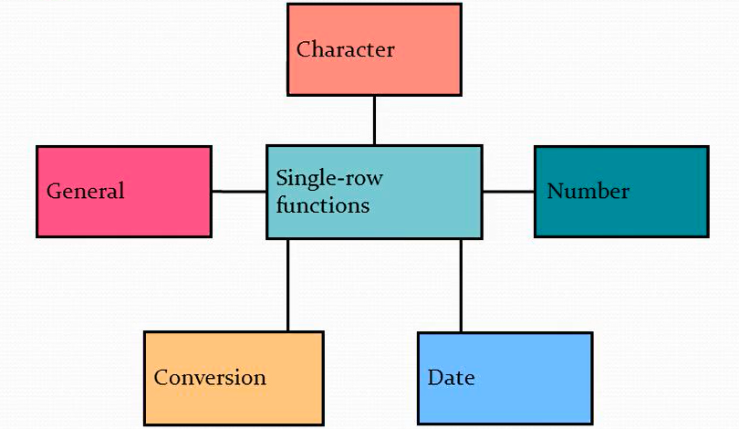
SQL - Single Row Function

Slide 8
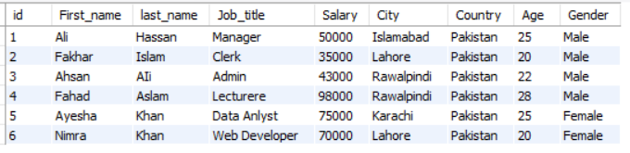
Single Row Function – (Character Function)

Slide 9
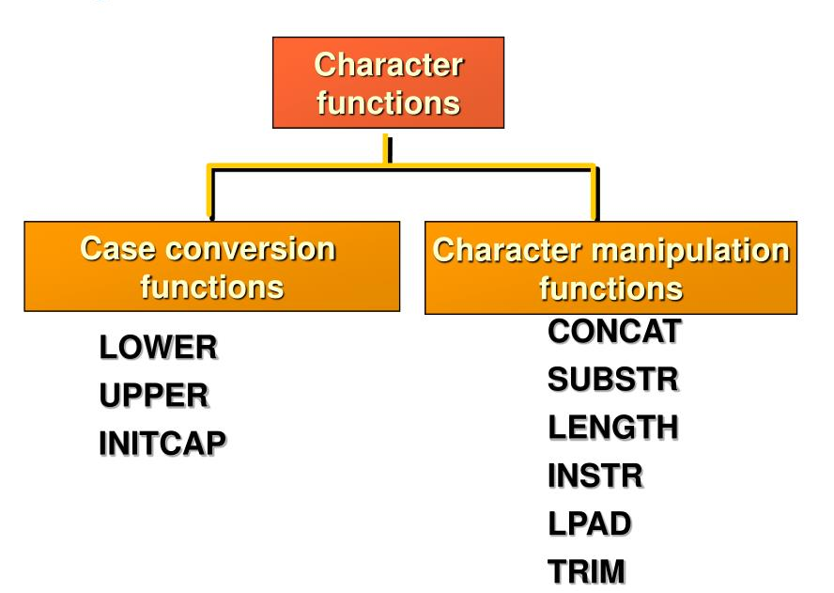
Single Row Function – (Character Function)

Slide 10
Single Row Function – (Character Function)
Function
Result
LOWER(‘Ali Raza')
UPPER(‘Ali raza')
ali raza
ALI RAZA
Syntax:
Select upper(column_name), lower(column_name) from table_name where condition;
Example:
Select upper(First_name), lower(Job_title) FROM sectionc.employee;

Slide 11
Single Row Function – (Character Function)
Text
Result
ali
Ali
Sql - Query:
SELECT CONCAT(UPPER(LEFT(First_name,1)), LOWER(RIGHT(First_name, LENGTH(First_name)-1))) AS name FROM sectionc.employee;

Slide 12
Single Row Function – (Character Function)
Text
Result
ali raza pakistan
Ali Raza Pakistan
Sql - Query:
SELECT CONCAT( UPPER(SUBSTRING_INDEX(first_name, ' ', 1)), ' ', UPPER(SUBSTRING_INDEX(SUBSTRING(first_name, CHAR_LENGTH(SUBSTRING_INDEX(first_name, ' ', 1)) + 2), ' ', 1)), ' ', UPPER(SUBSTRING_INDEX(SUBSTRING_INDEX(first_name, ' ', -2), ' ', -1)), ' ', UPPER(SUBSTRING_INDEX(SUBSTRING(first_name, CHAR_LENGTH(SUBSTRING_INDEX(first_name, ' ', 1)) + CHAR_LENGTH(SUBSTRING_INDEX(SUBSTRING_INDEX(first_name, ' ', -2), ' ', -1)) + 4), ' ', 1)) ) AS modified_textFROM sectionc.employee WHERE id = 7;

Slide 13
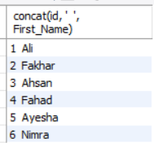
Character Manipulation Function – Concatenation
Syntax:
SELECT concat(column1, column2) AS "Student" FROM student;
Example:
SELECT concat(id,” ”, S_Name) AS "Student" FROM student;

Slide 14
Character Manipulation Function
Function
Result
CONCAT('Hello', 'World')
SUBSTR('HelloWorld',1,5)
LENGTH('HelloWorld')
INSTR('HelloWorld', 'W')
LPAD(salary,10,'*')
RPAD(salary, 10, '*')
REPLACE('HalloWorld’,‘a',’e')
TRIM('H' FROM 'HelloWorld')
HelloWorld
Hello
10
6
*****24000
24000*****
HelloWorld
elloWorld
Notes:
Select substr(First_Name, 1, 3 ) FROM sectionc.employee;Select Length(First_Name) FROM sectionc.employee;Select instr(First_Name, 'L') FROM sectionc.employee;Select LPAD(First_Name, '8', '*') FROM sectionc.employee;Select REPLACE(First_Name, 'a', '*') FROM sectionc.employee;Select Trim('A' from First_Name) FROM sectionc.employee;

Slide 15
Number Manipulation Function
Function | Value | Result
ABS | ABS(-43.25) | 43.25
Floor | Floor(2.6) | 2
CEIL | CEIL(1.40) | 2
Round() | Round(4.51) OR Round(4.49) | 5 OR 4
SQRT(number) | SQRT(64) | 8
POW(base, exp) | POW(2,3) | 8
Sign(number) | Sign(25), sign(0), sign(-25) | 1,0,-1
Rand() | 1 + Rand() * 5 | Any value between 1-5
MOD() | MOD(30, 7) | 2
Truncate() | truncate(40.7777, 2); | 40.77
Notes:
Select substr(First_Name, 1, 3 ) FROM sectionc.employee;Select Length(First_Name) FROM sectionc.employee;Select instr(First_Name, 'L') FROM sectionc.employee;Select LPAD(First_Name, '8', '*') FROM sectionc.employee;Select REPLACE(First_Name, 'a', '*') FROM sectionc.employee;Select Trim('A' from First_Name) FROM sectionc.employee;

Slide 16
Date & time Function
Create following table:
CREATE TABLE sectionc.Eventmange ( name VARCHAR(255), start_date DATE, end_date DATE, start_time time, end_time time);
Insert data:
INSERT INTO sectionc.Eventmange (name, start_date, end_date, start_time, end_time) VALUES ('Conference', '2024-05-15', '2024-05-17', '09:00:00', '17:00:00' );
Notes:
SELECT round(64.345);
Select id, name, age from table order by Rand()

Slide 17
Date & time Function - Arithmetic operation
Syntax:
Select column_name, column_name+7 from table where condition;
Example:
SELECT name, start_date, end_date, start_time, end_time, end_date + 7 FROM sectionc.Eventmange;
Notes:
SELECT round(64.345);
Select id, name, age from table order by Rand()

Slide 18
Date & time Function - Arithmetic operation
Syntax:
Select column1, column1- column2 from table where condition;
Example:
SELECT name, start_date, end_date, start_time, end_time, end_date - start_date FROM sectionc.Eventmange;
Notes:
SELECT round(64.345);
Select id, name, age from table order by Rand()

Slide 19
Date & time Function – Date Intervals
Syntax:
ADD_MONTHS ('11-JAN-94',6)
Example:
SELECT DATE_ADD('1994-01-11', INTERVAL 6 MONTH);
Notes:
SELECT DATE_ADD('1994-01-11', INTERVAL 6 MONTH);
SELECT DATE_ADD('1994-01-11', INTERVAL 6 day);
SELECT DATE_ADD('1994-01-11', INTERVAL 6 year);
SELECT DATE_ADD(DATE_ADD(DATE_ADD('1994-01-11', INTERVAL 2 DAY), INTERVAL 6 MONTH), INTERVAL 3 YEAR);

Slide 20
Date & time Function – Date Intervals
Syntax:
ADD_MONTHS ('11-JAN-94',6)
Example:
SELECT DATE_ADD('1994-01-11', INTERVAL 6 MONTH);
Notes:
SELECT DATE_ADD('1994-01-11', INTERVAL 6 MONTH);
SELECT DATE_ADD('1994-01-11', INTERVAL 6 day);
SELECT DATE_ADD('1994-01-11', INTERVAL 6 year);
SELECT DATE_ADD(DATE_ADD(DATE_ADD('1994-01-11', INTERVAL 2 DAY), INTERVAL 6 MONTH), INTERVAL 3 YEAR);
SELECT DATE_FORMAT(CURRENT_DATE(), '%Y-05-%d');

